Slide 1


5-MINUTE NEWS
LIVE
Understand news and know sentiment of news within 5 minutes

Slide 2
Team Members
—Ratima Sattaolankit 6610422001
—Nattachai Jairak 6610422021
—Jirawat Kemsatitanan 6610422024

Slide 3

Problem Statement
When reading a long news, you might…
Lazy to read
Do not have much time to read
Do not know English but want to understand news
Just want to know the sentiment of the news

Slide 4
OVERVIEWS
02
01
04
03
05
Sentimental Analysis
Summary
Summary Model Evaluation
Translation
Graphs &
Word Cloud

Slide 5
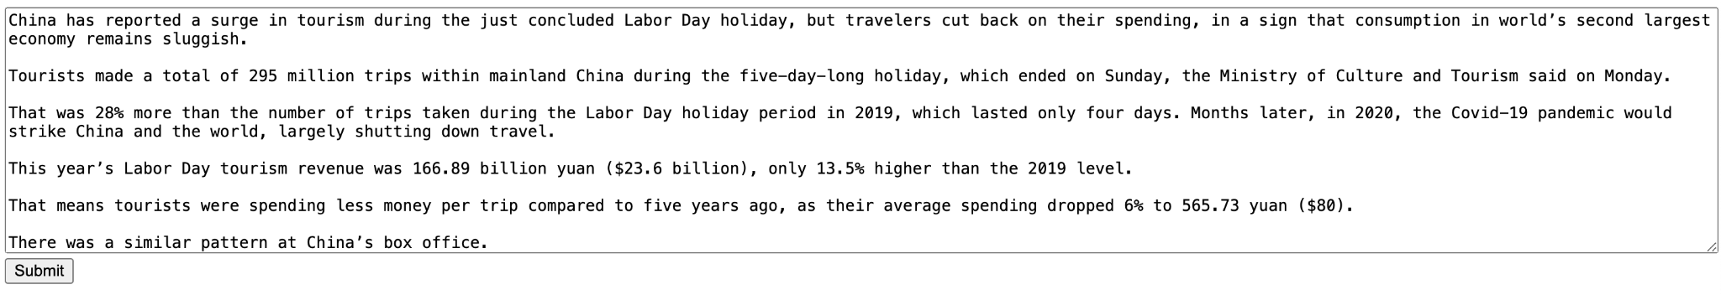
Summarizing News Got From News Website
facebook/bart-large-cnn
Falconsai/text_summarization
BART model pre-trained on English language, and fine-tuned on CNN Daily Mail.
The Fine-Tuned T5 Small is a variant of the T5 transformer model, designed for the task of text summarization. It is adapted and fine-tuned to generate concise and coherent summaries of input text

Slide 6
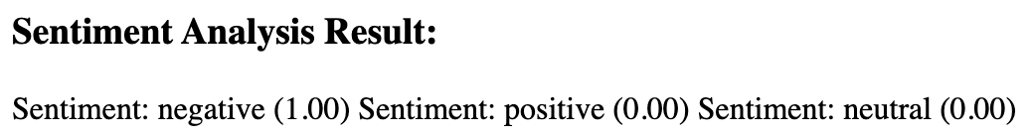
Sentimental Analysis
mrm8488/distilroberta-finetuned-financial-news-sentiment-analysis
To shortly understand the sentiment of news, we can look at the weight of score of positive, neutral, negative
😆
😐
😭

Slide 7
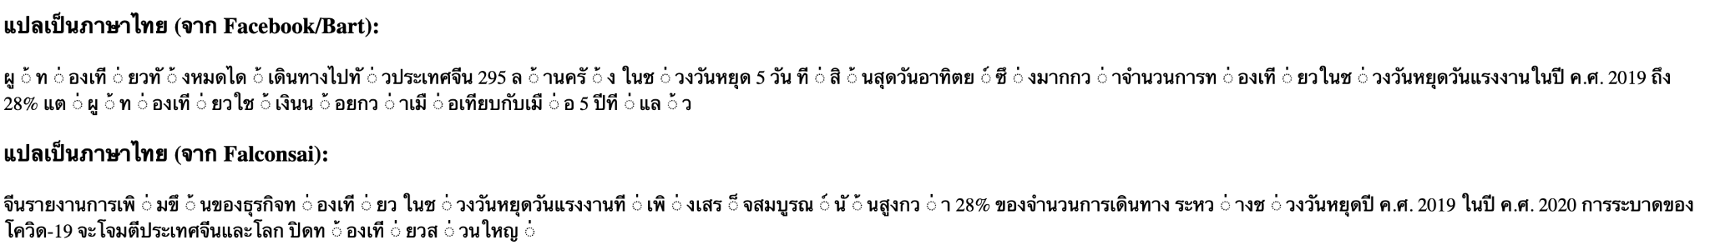
Thai Character alignment of Translation to Thai Hard to Read
facebook/mbart-large-50-many-to-many-mmt
Translate the news summaries from 2 model to Thai

Slide 8
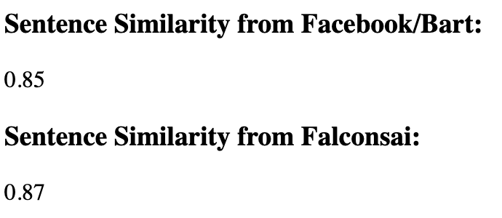

Summary Model Evaluation
Sentence Similarity
Of Summary 1
Original News
sentence-transformers/all-MiniLM-L6-v2
To pick the best summary, you can decide by looking at the score of similarity comparison that compare original news to the summaries from 2 models

Slide 9
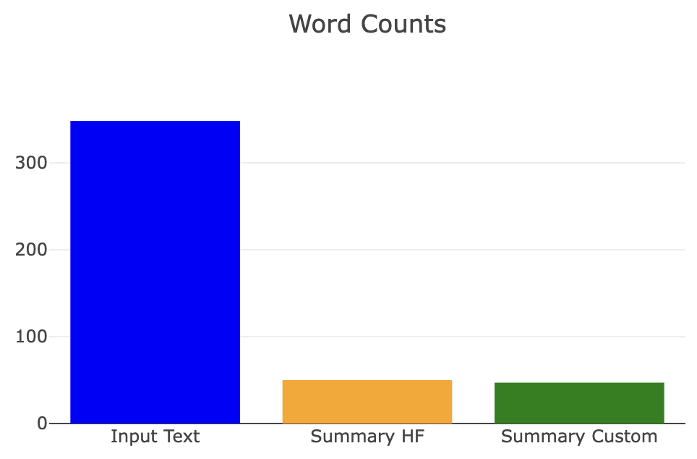
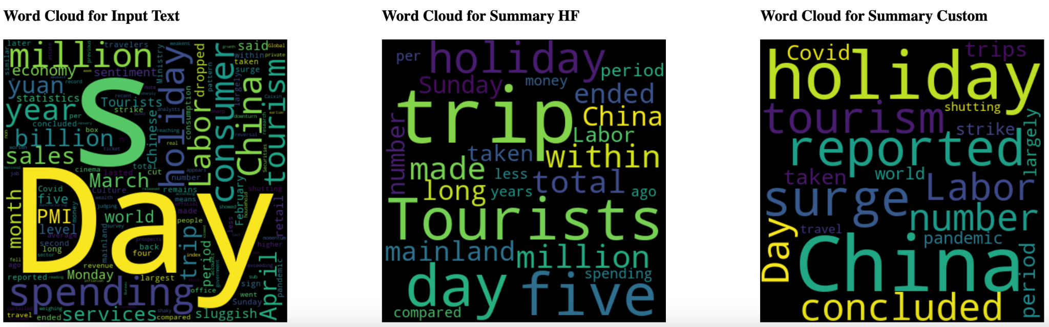
Graphs and Word Cloud
Bar Chart for Word Counts
Word Cloud For Input Text And Each summaries

Slide 10
Thank you

Slide 11
Appendix

Slide 12
For Further Improvement
Limit Text Input
Thai Character alignment of Translation to Thai Hard to Read
Text input box can support limit length of text, so now user can get the summaries from only some parts of the news. Therefore, there is need to develop to be able to support the long news.
This problem cause by the model, so there is need to develop the model to make thai text to be easy to read.

